Slide 1

Decision Trees
Nikhil Narayane
4th year Ph.D. Candidate
Department of Business Analytics & Statistics
Haslam College of Business
University of Tennessee, Knoxville
Notes:
Good afternoon everyone,
My name is Nikhil Narayane and I am 4th y ear Ph.D. Candidate in Department of Business Analytics & Statistics at University of Tennessee, Knoxville.
My today’s topic of presentation is Decision Trees.

Slide 2
Index
Introduction to Decision Trees
Understanding with an Example
Advanced Models
Concluding Remarks
Notes:
This is the structure of today’s presentation."
First, I will explain the motivation behind studying the decision trees.
Then we will study how to construct a decision tree using an example.
Then we will discuss certain advanced models which are built on the foundation of decision trees.
In the end, I will conclude the presentation with key takeaways.
"Let's start with the motivation—why do we need decision trees in the first place?"

Slide 3
Introduction to Decision Trees

Slide 4


What is Decision Tree?
Do I need an umbrella today?
Do I need to make reservation at the restaurant?
Notes:
In daily life, we continuously have to make actionable decisions such as
Do I have to carry an umbrella today?
Or
2. Do I have to make the reservation at the restaurant today?
Can I ask what was the last such decision you made today?
Link for photo - https://www.eater.com/2020/2/11/21128374/how-to-get-best-restaurant-table-reservations-apps

Slide 5
What is Decision Tree?
Do I need an umbrella today?
Do I need to make reservation at the restaurant?
What information do we need to make these decisions?
Today’s weather
Mode of transportation i.e. walk or drive
Whether the day is weekday or weekend?
What is the waiting time?
Notes:
We make decision based on our experience, information we have, So to make decisions for the given scenarios, such as whether to carry an umbrella, one would require information on weather prediction, that person’s mode of transportation, whether that person is walking or driving. Similarly, for deciding on making the reservation, one would consider whether the day of dining which he wants to go that restaurant is week day or weekend,
Our mind takes several such factors into consideration when making such decisions but the different individuals may give different importance to different variables and thus come to different conclusions.
To illustrate this, let's look at an example of a decision tree for the umbrella scenario.

Slide 6
Do I need to Carry an umbrella?
Will it rain according to weather check?
No
Yes
Decision Tree:
A decision tree is a non-parametric supervised learning algorithm
In simple words, a tree like model for making decisions.
Don’t carry the umbrella
Am I driving?
Yes
No
Is the parking lot at a distance from the destination?
Carry the umbrella
Yes
No
Carry the umbrella
Don’t carry the umbrella
Notes:
Here I have created a flowchart which shows how I would take decision in scenario of carrying the umbrella.
First I would see if it will rain. If the answer is no, then I will not carry the umbrella.
If the prediction shows that it will rain, then I will see if I am driving there or taking any other mode of transportation. If I am taking bus or bicycle, then I definitely carrying the umbrella,
However if I am driving to the place, then I would check if the parking place for car is close to the final destination or not. If it is in the same building, then I would not carry the umbrella but if it is at a distance then I would carry the umbrella. This is my decision-making process, but different individuals might approach it differently based on their preferences and priorities.
A flowchart like this that systematically guides decision-making is called a decision tree. It is called a "tree" because, just like a real tree, it starts from a root node and branches out into different decisions, with the final choices acting as leaves.

Slide 7
Terminologies
Will it rain according to weather check?
Root Node
No
Yes
Splitting
Don’t carry the umbrella
Am I driving?
Decision Node
Yes
No
Is the parking lot at a distance from the destination?
Carry the umbrella
Yes
No
Carry the umbrella
Don’t carry the umbrella
Leaf Node
Branch
Notes:
Here we get familiar with some key terminologies that we will use throughout the presentation."
The terminology is quite intuitive because decision tree follows the same structure as a real tree:
The root node is where the flowchart starts.
From the root node, the decision tree branches into different decision nodes, where choices are made.
The process continues until we reach a leaf node, which represents the final decision.
Any node between the root node and the leaf node is called a decision node, as it helps in making intermediate choices.

Slide 8
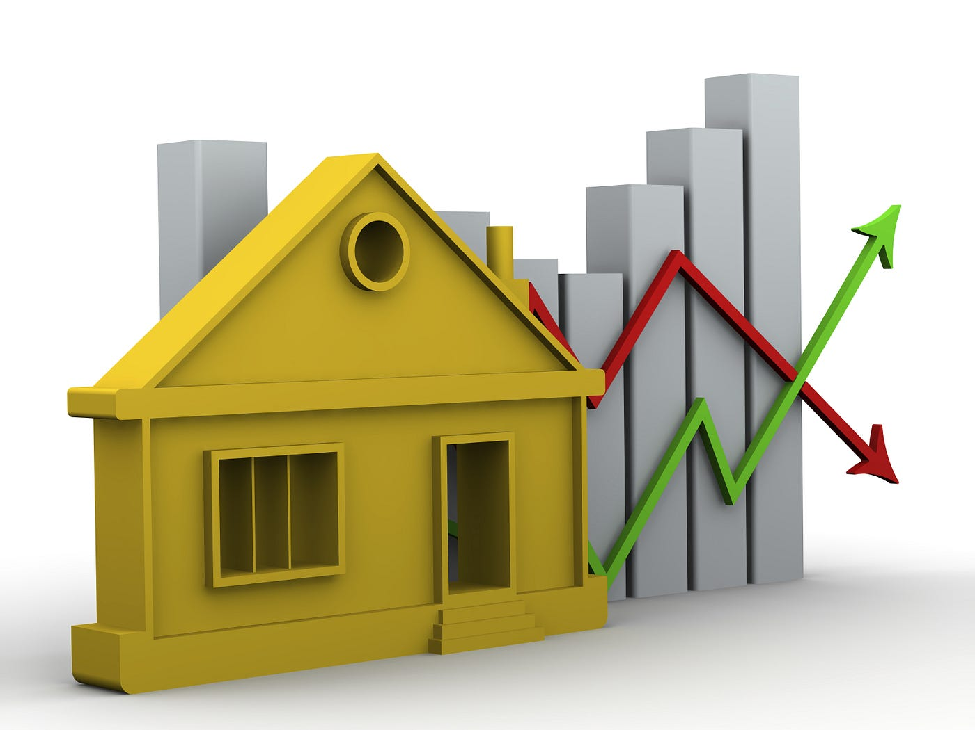


Types of Decision Trees
Classification Trees: when the output is categorical such as Loan Approval
Regression Trees: when the output is continuous such as Market House Price
Whether the bank will approve my loan?
Does the person have the disease?
Predicting house market price?
Regression Tree
Dollar value ($$$)
Classification Tree — Yes/No
Choosing one category out of a few
Notes:
Till now, we understood what is a decision tree and the terminologies used. We saw the example of creating a decision tree for the scenario of carrying the umbrella. In that case, the final decision was a yes or no decision. In many other cases, the final decision is not a categorical decision but requires a final output value. Decision trees can be used to make decision for those cases too. Such decision trees are called as Regression Trees.
Thus we can broadly classify Decision trees into two categories 1. Classification Trees: which is as the names suggest used to come to come to a categorical decision
2. Regression Tree: which is used to come to a final output value . For Example, we can use regression tree to predict the house market price based on several factors such as number of bedrooms, number of bathrooms etc.
For this presentation, we will only discuss classification tree.

Slide 9

Short Quiz
Notes:
Till now, we understood what is a decision tree and the terminologies used. We saw the example of creating a decision tree for the scenario of carrying the umbrella. In that case, the final decision was a yes or no decision. In many other cases, the final decision is not a categorical decision but requires a final output value. Decision trees can be used to make decision for those cases too. Such decision trees are called as Regression Trees.
Thus we can broadly classify Decision trees into two categories 1. Classification Trees: which is as the names suggest used to come to come to a categorical decision
2. Regression Tree: which is used to come to a final output value . For Example, we can use regression tree to predict the house market price based on several factors such as number of bedrooms, number of bathrooms etc.
For this presentation, we will only discuss classification tree.

Slide 10
Understanding Through an Example: Playing Tennis 🎾
Notes:
Lets understand how a to construct a decision tree using an example in python notebook.

Slide 11
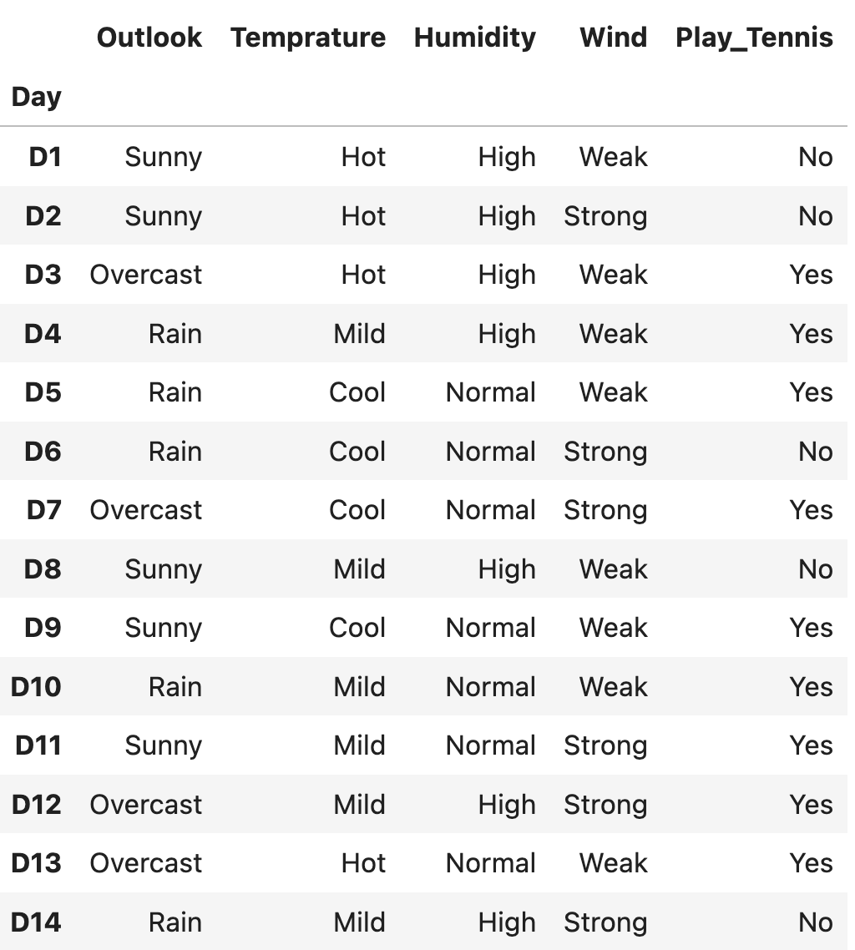
Should we go out to play Tennis?
Dataset has
Number of Observations: 14
Input Variables: Outlook, Temperature, Humidity, Wind
Decision Variables: Play Tennis (Yes or No) – Categorical
Which variables to select as Root Node?
Outlook or Temperature or Humidity or Wind?
Suppose we start with Temperature as Root Node
Then the next question is :
Which variables to select as Decision Node?
Outlook, Humidity, Wind
Notes:
Now, let's understand how decision trees work using an example."
We will be using the dataset of Playing Tennis. This dataset is available on Kaggle and is widely used to explain decision trees.
The data set has 14 observations
Number of observations: 14
Input variables: Outlook, Temperature, Humidity, Wind
Decision variable: Play Tennis (Yes or No)
The goal is to predict whether we should play tennis based on the given conditions.
We know by now that a decision tree starts with a root node.
In our previous umbrella example, we had two factors—rain prediction and mode of transportation. We started with rain prediction because it was the most important factor.
Could we have started with mode of transportation? Yes, but our brain instinctively picks the most relevant factor first.
Now, in our dataset, we have four input variables:
Outlook
Temperature
Humidity
Wind
Which one should be the root node?
If we randomly select a variable, say Temperature, as the root node, the next question is: "What should be the next decision node?"
We could create multiple decision trees, each with a different root node and decision nodes. However, we don't want to build an unnecessarily long decision tree.
The more steps (or nodes) a decision tree has, the longer it takes to make a decision and the more complex it becomes.
This is where decision tree algorithms come into play.

Slide 12
Node Selection Criteria
We select variable as Root Node which:
provides the most information about our target variable or that reduces uncertainty the most.
Therefore, in our example, we select variable as root node which affect the final decision of playing tennis the most
We measure uncertainty using methods like:
ID3 Algorithm (Information Gain - Entropy Based)
Measures uncertainty using Entropy.
Selects the feature with highest Information Gain (i.e., the one that reduces uncertainty the most).
CART Algorithm (Gini Index)
Uses Gini Impurity to measure uncertainty.
Selects the feature that gives the lowest Gini Index, meaning it creates purer splits.
Once we select the Root Node, then we repeat the above procedure for decision nodes.
Notes:
Now that we understand why we need to select the right root node and decision nodes, let’s discuss how decision tree algorithms make these choices."
There are different ways to determine which variable should be used for the root node and subsequent decision nodes. Two of the most popular algorithms for this are:
ID3 Algorithm
CART Algorithm We will not go into complete details of the above methods, but in general, these methods select variables which maximize certainty in decision making.
Each of these algorithms selects the best variable to maximize certainty in decision-making. Another way to think about this is that they try to reduce uncertainty at every step.
Imagine making a decision:
If we have more certainty about different factors involved in making a decision, we can confidently make a clear decision without hesitation.
If we have more uncertainty, we might hesitate or make the wrong choice.
These algorithms aim to reduce uncertainty by choosing the variable that brings us closer to a definite decision. Each algorithm has a different way of measuring uncertainty:
ID3 Algorithm uses Information Gain, which is based on Entropy (a measure of disorder or randomness).
CART Algorithm uses the Gini Index, which focuses on impurity (how mixed the data is in a given split).
For this presentation, we will focus on the Gini Index as our method to measure uncertainty.
How Does the Gini Index Work?
Think of uncertainty as messiness in a decision.
Imagine a group of people and they have to make certain decisions, then the group has mixed outcomes (some "Yes," some "No"), or we say we have high uncertainty (high impurity).
If a group has all "Yes" or all "No", we have low uncertainty (high purity).
The goal of the Gini Index is to split the data in a way that reduces impurity, meaning that each new group (or split) is as pure as possible.
The more uncertainty we remove, the clearer and more confident our final decision will be.

Slide 13
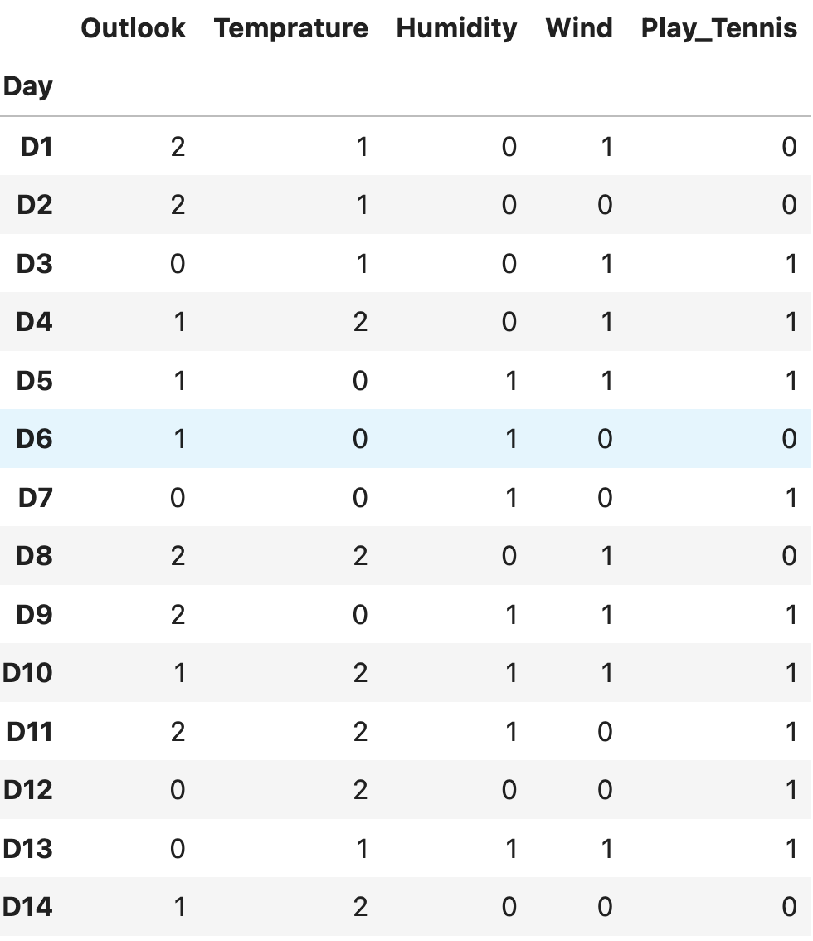
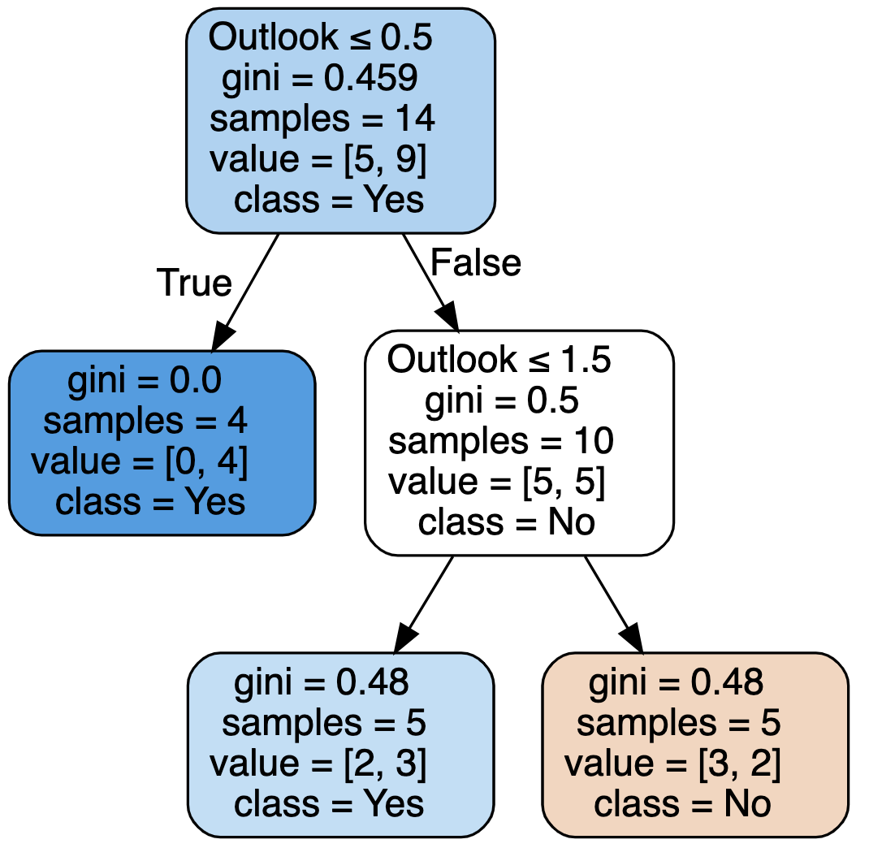
Using only ‘Outlook’
Decision Tree for Play Tennis Dataset
Interpretation:
If “Outlook < 0.5” (meaning Overcast), then “Play Tennis”
If “0.5 < Outlook < 1.5” (meaning Rain), then “Don’t Play Tennis”
Notes:
Before we build a full decision tree using multiple variables, let's first understand how decision trees work by using only one variable at a time."
The purpose of doing this is to understand how single variable influences decision making and whether we are able to make good enough predctions just using one variable "Let's start by building a decision tree using only the 'Outlook' variable."
We will check whether the Outlook (Sunny, Overcast, or Rain) is enough to decide whether we should play tennis. To construct the decision tree, we will use the following python function. We will understand this function in a while. For now, lets try to understand the decision tree.
We see

Slide 14
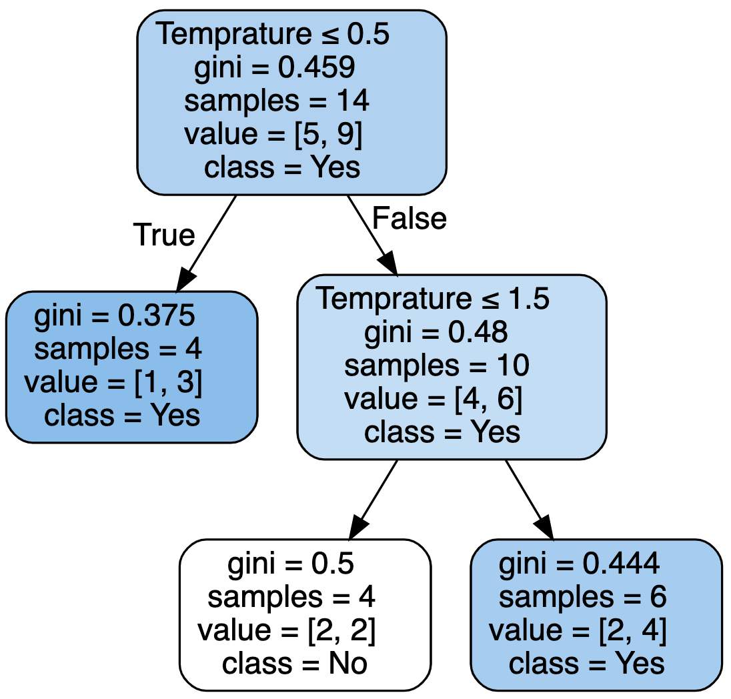
Using only ‘Temperature’
Decision Tree for Play Tennis Dataset
Interpretation:
If “Temperature < 0.5” (meaning Cold), then “Play Tennis”
If “0.5 < Temperature < 1.5” (meaning Hot), then “Don’t Play Tennis”
If “Temperature > 1.5” (meaning Mild), then “Play Tennis”
Notes:
We want to know whether to carry an umbrella or not.
In the flowchart, we can see how an individual like me would make decision.
The first thing I would do is check the weather prediction.
If the weather prediction says that it will not rain, then I will not carry an umbrella, otherwise if it says it will rain, then I will check if I am driving. If I am not driving.
Such a flowchart is called as decision tree which is used to make decision regarding ‘Yes/No’.

Slide 15
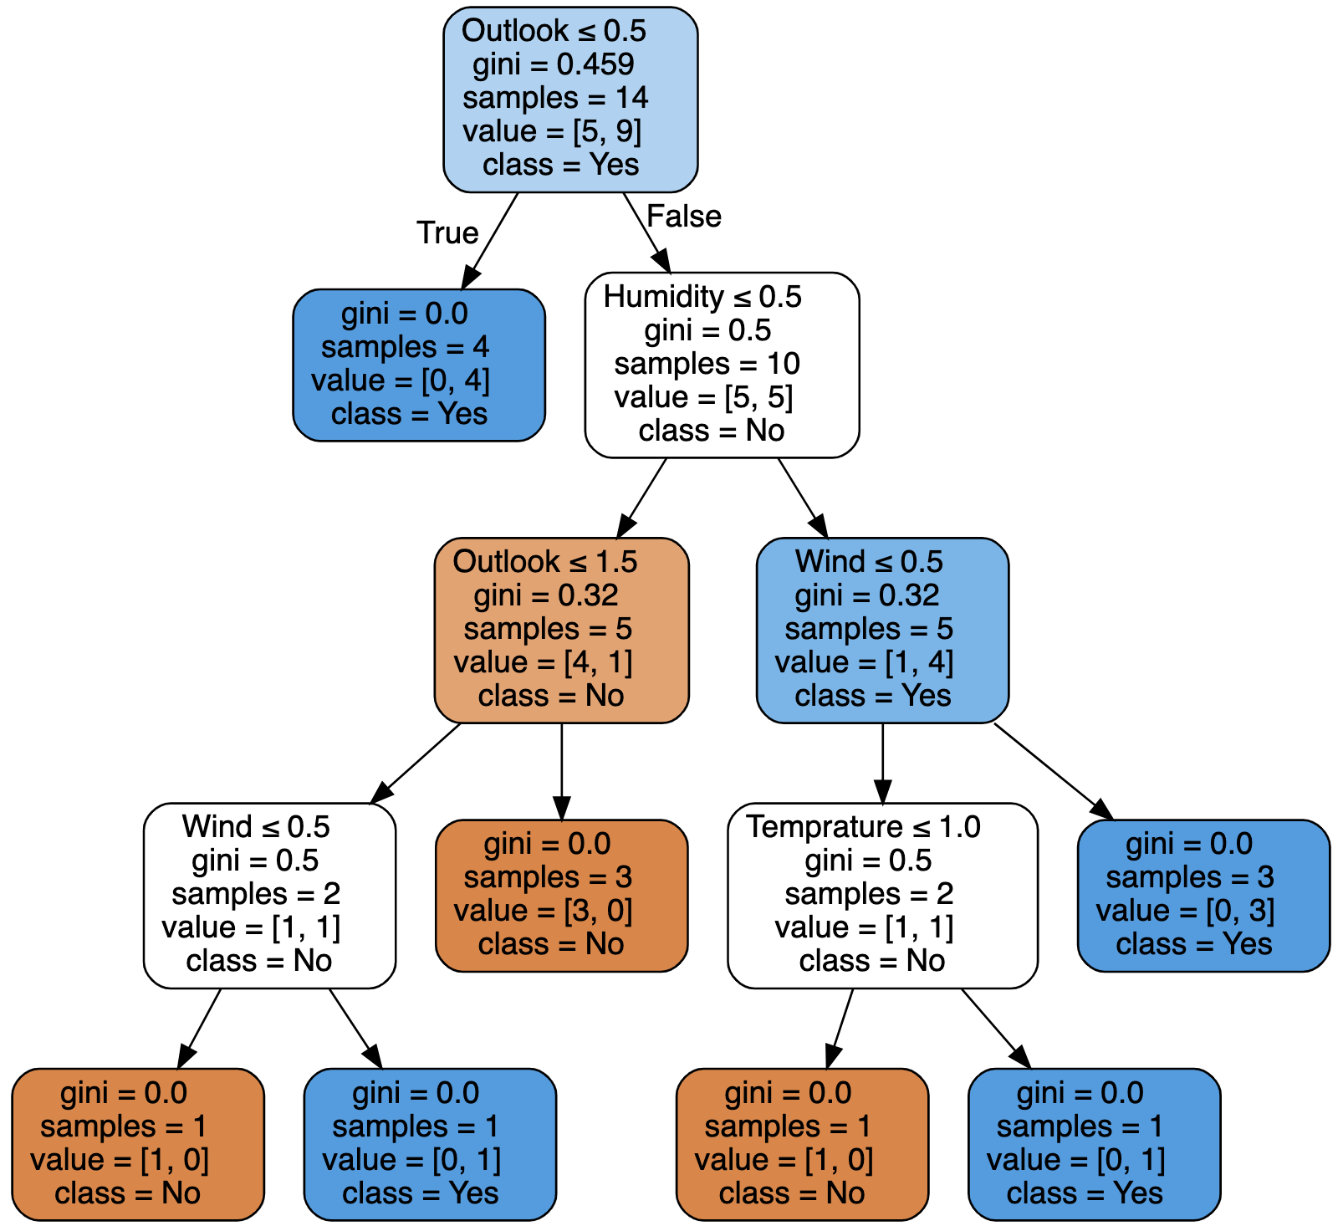
Using all the features
Decision Tree for Play Tennis Dataset
Notes:
We want to know whether to carry an umbrella or not.
In the flowchart, we can see how an individual like me would make decision.
The first thing I would do is check the weather prediction.
If the weather prediction says that it will not rain, then I will not carry an umbrella, otherwise if it says it will rain, then I will check if I am driving. If I am not driving.
Such a flowchart is called as decision tree which is used to make decision regarding ‘Yes/No’.

Slide 16

Short Quiz
Notes:
Till now, we understood what is a decision tree and the terminologies used. We saw the example of creating a decision tree for the scenario of carrying the umbrella. In that case, the final decision was a yes or no decision. In many other cases, the final decision is not a categorical decision but requires a final output value. Decision trees can be used to make decision for those cases too. Such decision trees are called as Regression Trees.
Thus we can broadly classify Decision trees into two categories 1. Classification Trees: which is as the names suggest used to come to come to a categorical decision
2. Regression Tree: which is used to come to a final output value . For Example, we can use regression tree to predict the house market price based on several factors such as number of bedrooms, number of bathrooms etc.
For this presentation, we will only discuss classification tree.

Slide 17

Decision Trees: Benefits & Drawbacks
Benefits:
Easy to interpret
Drawbacks:
Prone to overfitting
Costly computations
Litle data preparation required
Flexible — regression and classification
High variance estimators
Notes:
Easy to interpret: The Boolean logic and visual representations of decision trees make them easier to understand and consume.
Little to no data preparation required: It can handle various data types—i.e. discrete or continuous values, and continuous values can be converted into categorical values through the use of thresholds.
More flexible: Decision trees can be leveraged for both classification and regression tasks, making it more flexible than some other algorithms.
Prone to overfitting: Complex decision trees tend to overfit and do not generalize well to new data. This scenario can be avoided through the processes of pre-pruning or post-pruning
High variance estimators: Small variations within data can produce a very different decision tree.
More costly: Given that decision trees take a greedy search approach during construction, they can be more expensive to train compared to other algorithms.

Slide 18
Advanced Models
Model | Main Concept | Pros ✅ | Cons ❌ | Best Use Cases
Random Forest | Multiple Decision Trees (Bagging) | Reduces overfitting, robust | Slower than a single tree | General-purpose, tabular data
Gradient Boosting (GBM) | Sequentially improves weak trees | High accuracy, handles missing data | Slower training, sensitive to tuning | Structured data, competition settings
XGBoost | Optimized GBM | Fast, efficient, regularized | More complex tuning needed | Kaggle competitions, business problems
LightGBM | Leaf-wise tree growth | Faster than XGBoost, efficient | Sensitive to hyperparameters | Large datasets, real-time predictions
CatBoost | Handles categorical data well | No need for heavy preprocessing | Computationally expensive | High-cardinality categorical data
Extra Trees | Randomized tree splits | Very fast, reduces variance | May lose accuracy | Large datasets, when speed is critical
Notes:
We want to know whether to carry an umbrella or not.
In the flowchart, we can see how an individual like me would make decision.
The first thing I would do is check the weather prediction.
If the weather prediction says that it will not rain, then I will not carry an umbrella, otherwise if it says it will rain, then I will check if I am driving. If I am not driving.
Such a flowchart is called as decision tree which is used to make decision regarding ‘Yes/No’.

Slide 19
Conclusion
1. Simple Yet Powerful
Intuitive, flexible and powerful
Visualization of feature importances
Accurate Predictions
2. Limitations and Enhancements
Can overfit on training data easily
Many enhanced versions like XGBoost, LightGBM, etc.
3. Real-World Applications
Widely used in real-world applications including healthcare, forecasting and predictions
HP, Bombardier, Wayfair, etc.
4. Choosing the Right Model
Interpretibility → Decision Trees
Accuracy → Random Forest and Boosting
Speed and Scalability → LightGBM, XGBoost, CatBoost
Notes:
We want to know whether to carry an umbrella or not.
In the flowchart, we can see how an individual like me would make decision.
The first thing I would do is check the weather prediction.
If the weather prediction says that it will not rain, then I will not carry an umbrella, otherwise if it says it will rain, then I will check if I am driving. If I am not driving.
Such a flowchart is called as decision tree which is used to make decision regarding ‘Yes/No’.

Slide 20
Thank You
Questions?
My Email Id: Nikhil.Narayane99@gmail.Com
My Personal Website: www.Nikhil9.In
My Youtube Channel:
Nikhilstat
Notes:
If we could predict the outcomes for unknown situations, we could tap potential markets and inmprove operation
Preparing for an event that has not happeed can help us tap potential markets.
This is where predictive analytics helps us.
https://online.hbs.edu/blog/post/predictive-analytics
https://www.retailbankerinternational.com/news/cba-fraud-speeds-ai/?cf-view
Start with these examples,
And that is why company use predictive analytics

